Slide 1
14 October 2015
1200 UTC
Forecasting for Day 2

Slide 2
NWP based tools

Slide 3
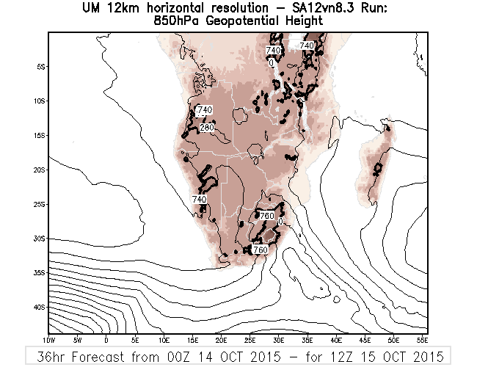
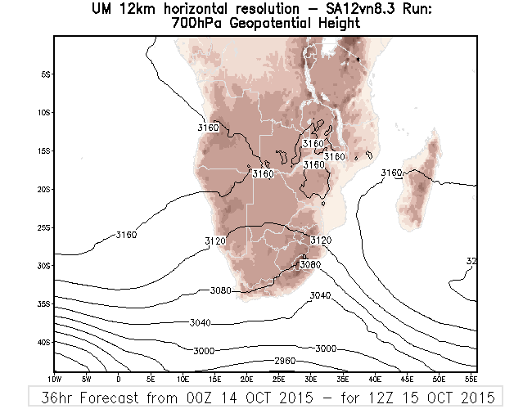
NWP 36h forecast – i.e. 1200 UTC 15 Oct

Slide 4
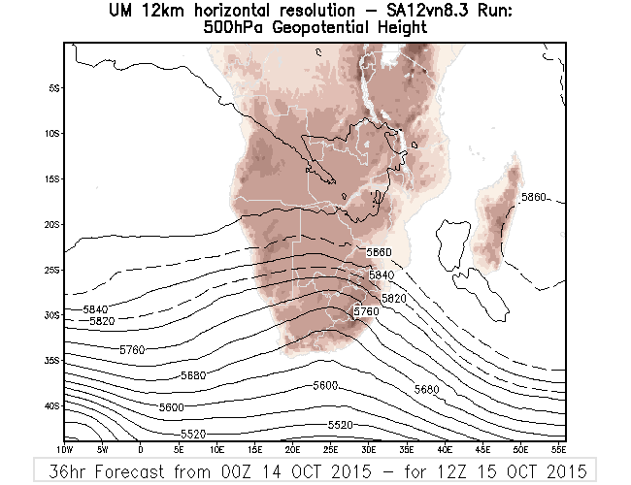
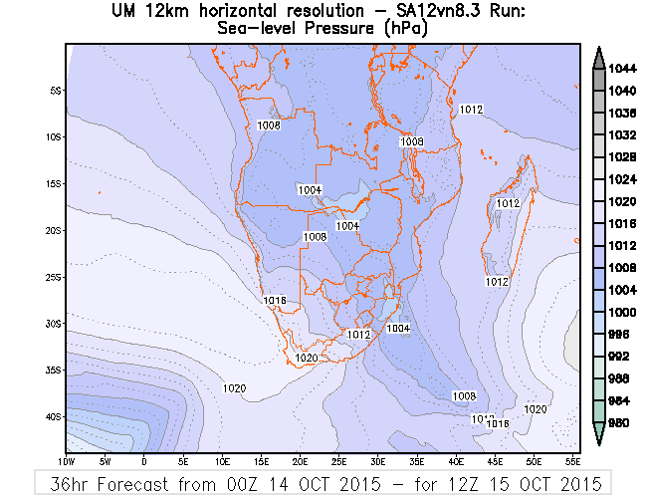
NWP 36h forecast – i.e. 1200 UTC 15 Oct

Slide 5
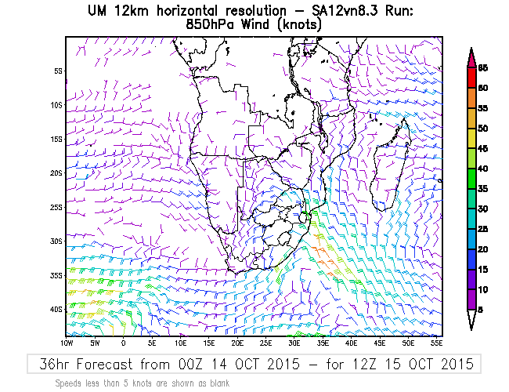
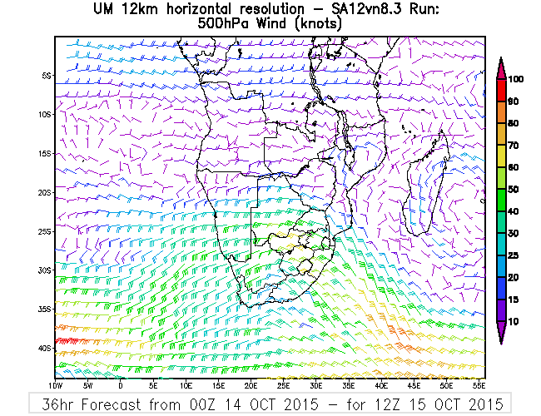
NWP 36h forecast – i.e. 1200 UTC 15 Oct

Slide 6
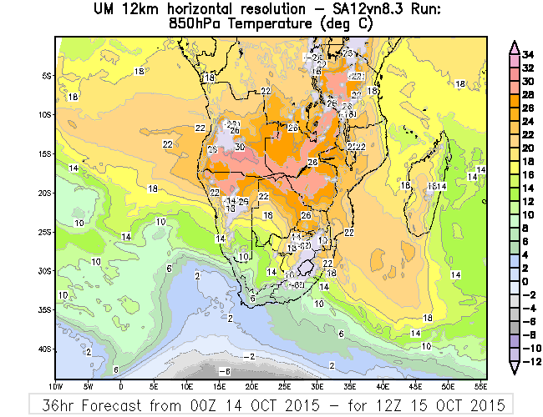
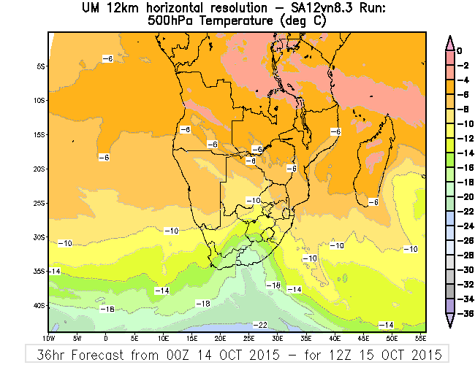
NWP 36h forecast – i.e. 1200 UTC 15 Oct

Slide 7
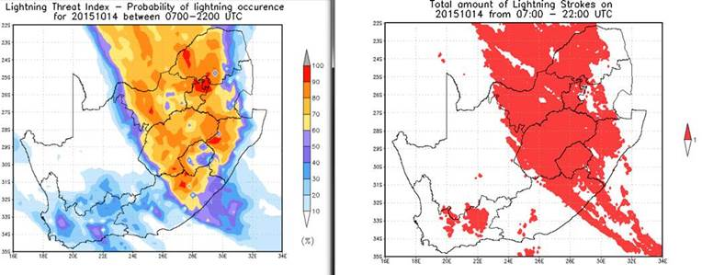
LTI – day1 forecast for 14 Oct

Slide 8
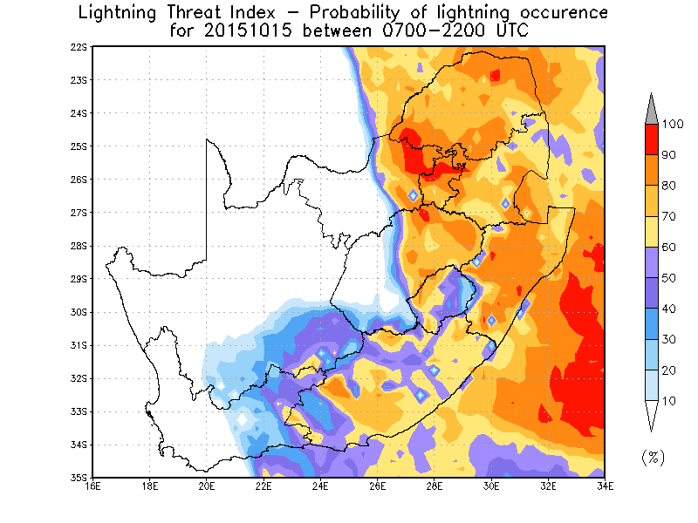
LTI – day 2 forecast for 15 Oct

Slide 9
1. Looking at the provided NWP fields where would you expect convection in the afternoon of the 15th (after 1200 UTC)?
2. Use the map provided to draw an area where you expect convective development and give probabilities – e.g. 30%, 60%, 80% and 100% chance of convection

Slide 10
Expectation for Day 2

